Slide 1



Network API Challenge | Institute for Computing, Information and Cognitive Systems (ICICS) (ubc.ca)
Rogers Communications and The University of British Columbia (UBC), in collaboration with Ericsson, GSMA and partners, are organizing a hashtag#hackathon based on a digital transformation that shakes the global hashtag#telecom industry on Thursday [1], namely Network APIs [2]. The weekend event on October 4-6, 2024 at UBC's Point Grey campus is open to all UBC students who like to write software and business cases. This includes, but not limited to, our students in UBC Science, UBC Computer Science, UBC Engineering, UBC Electrical and Computer Engineering, UBC Sauder School of Business, UBC Graduate School, and UBC Okanagan. Be one of the first cohorts of students in Canada to experience (and work with) the next game changer in hashtag#5G technology [3]. Sign up for the hashtag#networkAPIs hackathon and the preparation workshop with your hashtag#UBC student email here: https://lnkd.in/ggz9pdr7
References: [1] Global telecom leaders join forces to redefine the industry with network APIs https://lnkd.in/gD_DvYNn [2] GSMA Open Gateway API Descriptions https://lnkd.in/gY8TgY2G [3] Discover the potential of Network APIs https://lnkd.in/gGi_6Pau

Slide 2
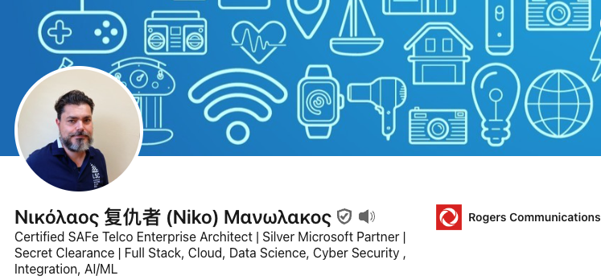
Network API Challenge | Institute for Computing, Information and Cognitive Systems (ICICS) (ubc.ca)
Rogers CAMARA / Network as a Service Technical Product Owner, Nicholas Manolakos , Sr. Developer Architect. Partnerships and Innovation
https://www.linkedin.com/in/nm3sys/
nmanolak@rci.rogers.com

Slide 3
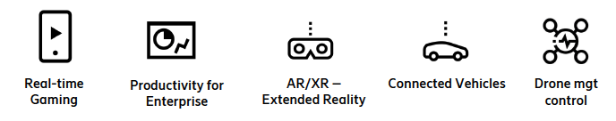

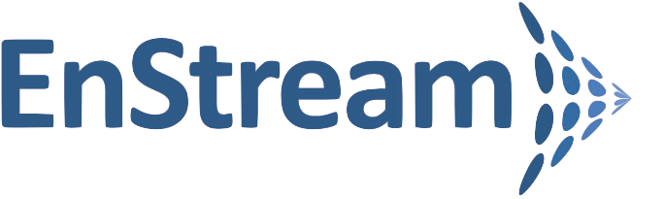

Project RAPID - Introduction and Program Overview Network APIs / Network as a Service
API CALLS
Network APIs allow ISVs to get information out of a network and configure a network
They are a big step in the monetization of 5G networks
Network APIs are not new but at MWC 2023, GSMA announced a standardization program that is bringing carriers together to create more value to the ISVs and allow operators to capture a significant market share
Near-term market focus is on APIs addressing anti-fraud and identity use cases
MONEY FLOW
Independent software vendors
Collects payment
Aggregates API calls across carriers to provide single end point
Quick Glance: Projected
Opportunity by 2028 (USD)
Benefit to Developers
Allows developers to configure networks based on application needs rather than work around their limitations [Key opportunity for telcos but will not be fully ready until DMC is complete].
Provides an interoperable, simplified and scalable way to validate user information for account creation/access and to prevent fraud.
World: $22 Billion
Canada: $420 Million
*assuming 2% of global market share
For Rogers: $145 Million**
*assuming of 1/3 Canadian market share
AGGREGATOR
Pays operators for API (minus marketplace %)
API Call
API Call
API Call
Source: STL Partners
**McKinsey reported in Feb 2024 to 1B opportunity for Rogers by 2030
CARRIERS

Slide 4



Background: GSMA Open Gateway Network API
What is GSMA Open Gateway?
Framework of common Network APIs designed to provide universal access to operators' networks for developers
GSMA Open Gateway Footprint
Key Industry Forums
47
Mobile Operator Groups
Governing body defining the technical and business principle for NaaS with the establishment of the GSMA Open Gateway
239
Mobile Networks
Service APIs
App-centric developer oriented
CAMARA is an open-source project defining the standardize spec and design of APIs
Operate APIs
Management oriented
Dedicated group defining how APIs services are to be operated and managed.
65%
Connections around the world

Slide 5
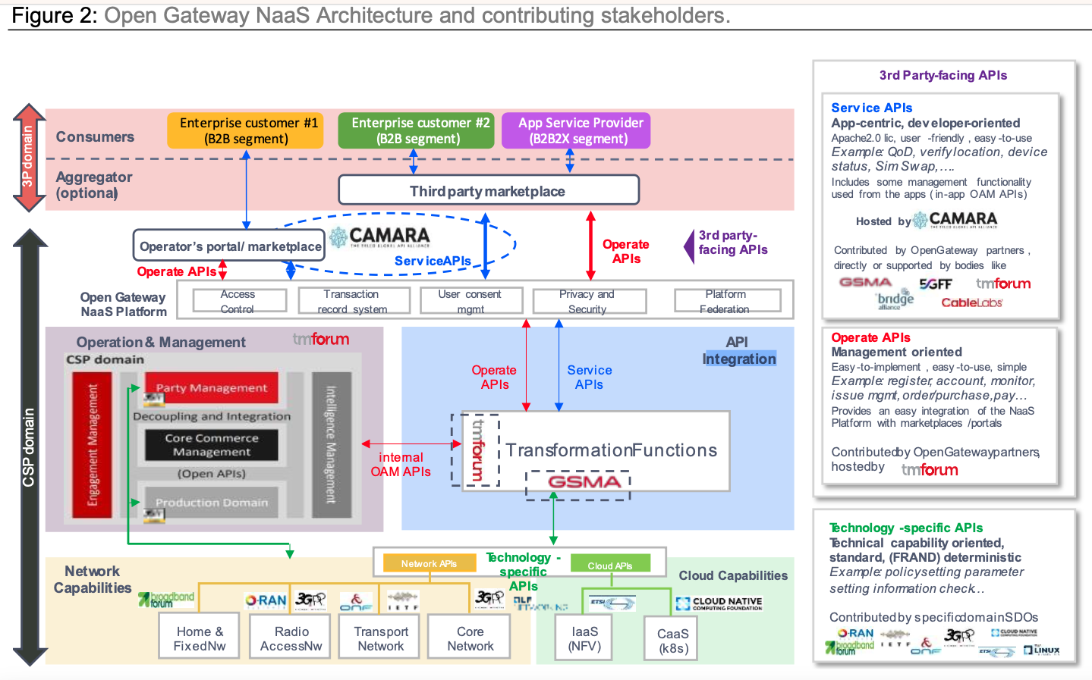
Rogers RAPID ROADMAP

Slide 6
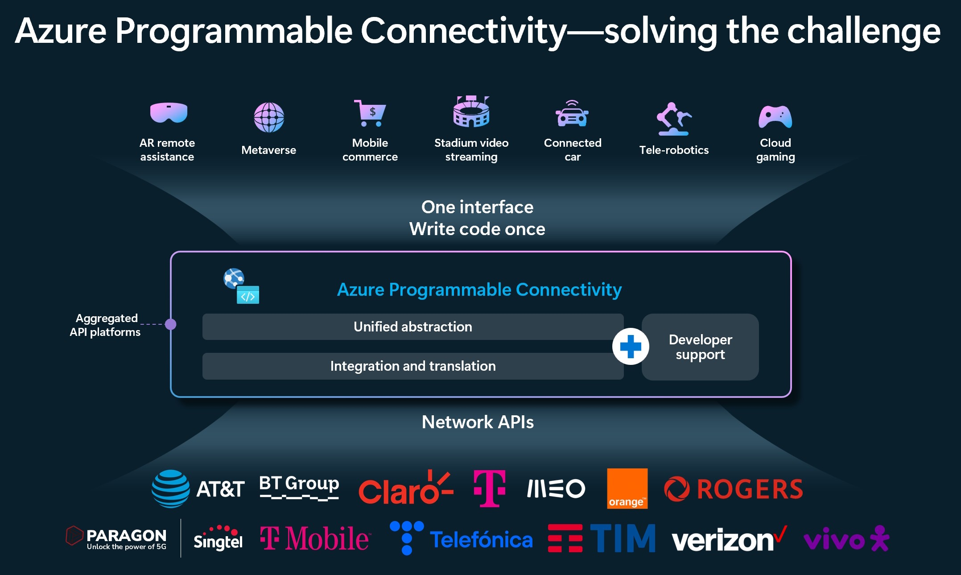
Microsoft Azure Programable Connectivity (APC)
Notes:
Rogers is working with Microsoft Azure on a new Azure Resource called “Azure Programable Connectivity (APC) .”Among other worldwide operators and competitors, Rogers will publish Network-as-a-Service GSMA Open Gateway Linux Foundation CAMARA API to focus on Fraud Prevention and Digital Identity Use Cases for Independent Software Vendors (ISV). Similar to how Rogers, Bell and Telus’s joint venture called https://Enstream supports the Canadian banking industry with similar APIs and use cases.
As a Mobile Network Operator, we partner with Colony Networks (https://www.colonynetworks.com) to manage Fixed Wireless Access Points (FWA) and IoT devices, for business customers on our Network. We use geofencing for our Business Customers, like Loblaws (https://www.loblaws.ca), to restrict their operations within a specific location matching their postal code within a fixed distance.
Potential use cases for the Rogers APC are Auto-theft prevention, Digital Identity, and Fraud Prevention suite can be incorporated into Connected Car, and rules can be set for the car to only start within a specific geofence of the proximity of the owner’s mobile.
We work with Technology platform teams like Jean Michel Dupuis’s 911 and Commercial Value-added Services (VAS) services to allow 3rd party programmatic access to mobile subscribers’ IT services and Network resources, such as Name, Addresses and real-time location queries and other supporting use-cases like fraud and digital identity by selling these API though hyper-scalers or aggregators.

Slide 7
GSMA Camara Standardized API List
API Portfolio | Anti-Fraud | Mobile Connectivity/Value-Added Services |  | Fixed Connectivity | Cloud & Edge | Payments
API Product Family | Subscriber Identity | Location | Network Quality/Optimization | Network Quality/Optimization | MEC | Payment and Charging
CAMARA API | Device Status Check connectivity status of UE | Device Location Verification UE location check to proximity of a given location | Connectivity Insights Check if networking requirements are met | Home Device QoD Enable configuration to users WiFi connectivity | Simple Edge Discovery Enable discovery to closest edge-cloud node to connect | Carrier Billing Enable purchases to request payment via carrier billing system
 | IMEI Fraud Check if IMEI is blacklisted | Geofencing Enable changes base on geographic position | Mobile Quality on Demand Enable time bounded network configuration |  | Traffic Influence Geographic Traffic optimization for Edge Application Server
 | KYC Fill-in Pull customer info from operator database | Location retrieval Retrieve location via Mobile network | WebRTC Add communications capabilities (video, voice, etc.)
 | KYC Match Check customer info from operator database
 | Number Verification Authentication of UE by Mobile network
 | SIM Swap Check last time the SIM card has changed
 | One Time Password (SMS) Send short-lived one time password via SMS
 | Blockchain Public Address Bind/unbind public addresses

Slide 8
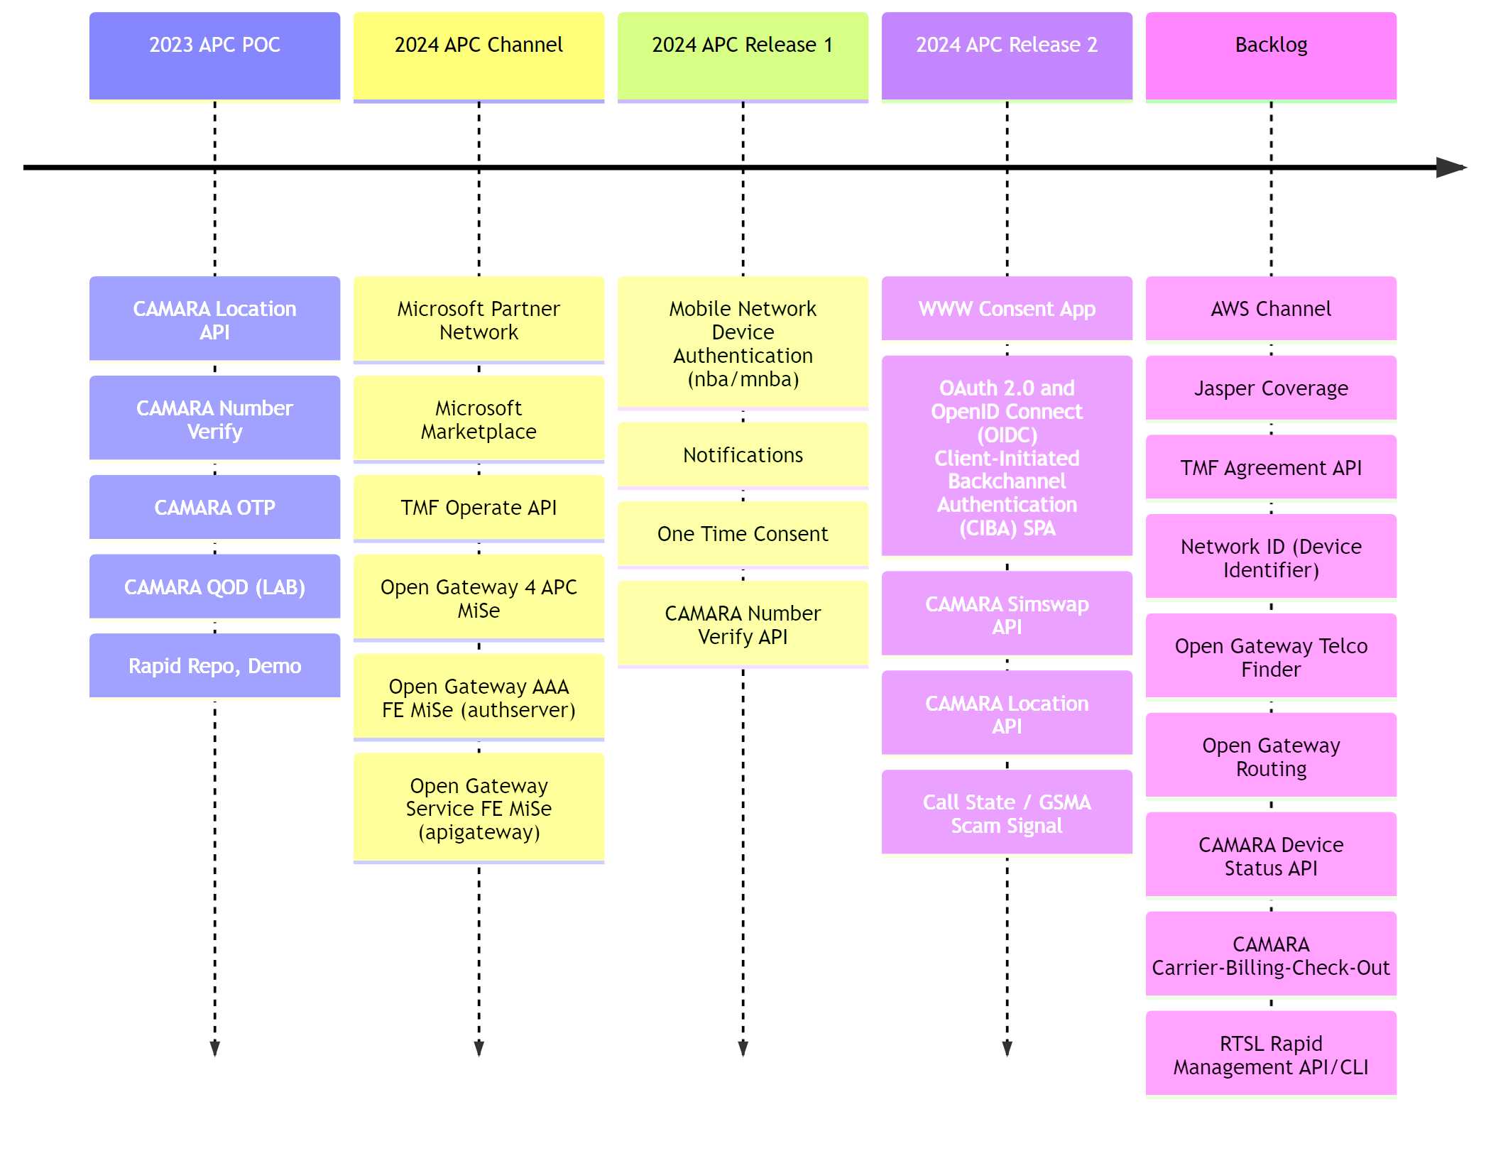
ROADMAP

Slide 9
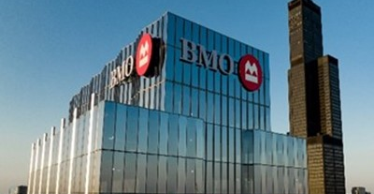


Rogers CAMARA Channels
ACTIVE
2025+
2026+
Enterprise
Start-Up/SME
Industry (Proprietary)
B2B2C model
Anti-fraud and identity use cases
Available through EnStream
B2B2C model
Anti-fraud and identity use cases (primary focus on standardized CAMARA APIs)
Available through API marketplaces and aggregator
B2B / B2B2B model
Network optimization, MEC, connectivity, location and robust anti-fraud and identity use cases
Available via Rogers Developer Portal, marketplaces and aggregator sites or via our out-sourced

Slide 10





Network API Use Cases
PHONE NUMBER: (555) 555-5555
INFO PROVIDED
INFO VERIFIED
ACCOUNT CREATION
Validate a is person is who they claim.
ACCOUNT ACCESS
Prevent fraudulent account access.
First Name
Last Name
Login Location
Address
City
Postal Code
First Name
Last Name
Device Location
Address
City
Postal Code
DEVICE MANAGEMENT
Track and manage any SIM powered device.
QUALITY OF SERVICE
Prioritize latency based on application needs.
Fraud Detected
PHASE 1 FOCUS: Fraud Prevention and Digital Identity Use Cases

Slide 11
Usecases
Use Case 1a: Location Verification Sharing with APC GSMA Opengateway Outh2 OIDC CIBA Flows
Consent Request Initiation: CA Auto Insurance decides to request real-time location data from Maria to offer a personalized insurance quote. CA sends a custom SMS to Maria, containing a secure link to initiate the consent process. This message explains the “Purpose”, “Period”, and “Scope” of the location data sharing, in line with Rogers’ and Microsoft Azure APC’s privacy policies.
CIBA Authentication Initiation: Upon Maria clicking the link, instead of being directed to a login page, a CIBA flow is initiated. Rogers, acting as the IDP, receives a backchannel authentication request from CA. Rogers verifies if the request is legitimate and if Maria has previously granted consent for such requests.
Authentication and Consent Notification: Rogers sends a notification to Maria’s registered device, asking her to authenticate and approve the data-sharing request. Maria authenticates using her preferred method (e.g., biometrics, one-time password) via the Rogers app or website, which ensures her identity is confirmed securely without redirecting her to a login page.
Informed Consent and Approval: Post-authentication, Maria is presented with detailed consent information within the Rogers app or notification interface. This step reaffirms the “Purpose”, “Period”, and “Scope” of sharing her location data. Maria reviews and grants consent through this interface, streamlining the process.
Token Issuance and Data Sharing: Once Maria consents, Rogers notifies CA through the backchannel that consent has been granted. Rogers issues a token to CA, enabling them to access Maria’s real-time location data through the Rogers CAMARA Location API. This ensures that CA receives the necessary data to provide a personalized insurance quote to Maria.
Security and Verification: Rogers continues to use robust verification protocols to confirm the authenticity of the location data and the security of Maria’s account. This step is crucial for maintaining trust and ensuring that the data shared is accurate and secure.
Consent Revocation and Lifecycle Management: After the agreed-upon period ends or at any time Maria decides to revoke her consent, Rogers facilitates this process, ensuring that CA no longer has access to her location data. Rogers manages the consent lifecycle, adhering to privacy standards and regulations, and records all transactions for audit and compliance purposes.

Slide 12
Usecases
Use Case 2: SIMSWAP for Fraud Prevention with APC GSMA Opengateway Outh2 OIDC CIBA Flows
Consent Request Initiation: When Eleni applies for a new credit card using her banking app, the Royal Bank of Canada (RBC) decides to verify the legitimacy of her SIM card to prevent fraud. RBC sends Eleni a custom SMS, containing a secure link to initiate the consent process for SIMSWAP data sharing. The SMS explains the “Purpose”, “Period”, and “Scope” of the SIMSWAP data sharing, in line with the privacy policies of Rogers and Microsoft Azure APC.
CIBA Authentication Initiation: Instead of directing Eleni to a traditional login page after she clicks the link, a CIBA authentication flow is initiated. Rogers, acting as the Identity Provider (IDP), receives a backchannel authentication request from RBC. Rogers verifies if the request is valid and checks if Eleni has pre-authorized such requests.
Authentication and Consent Notification: Rogers sends a notification to Eleni’s registered device, prompting her to authenticate and approve the SIMSWAP data-sharing request. Eleni authenticates via the Rogers app or website using her preferred method (e.g., biometrics, one-time password), ensuring a secure and seamless user experience without needing to manually log in.
Informed Consent and Approval: After successful authentication, Eleni is presented with the consent information directly within the Rogers app or through a secure notification. This interface clearly outlines the “Purpose”, “Period”, and “Scope” of sharing her SIMSWAP data with RBC. Eleni reviews the information and grants her consent within this secure environment.
Token Issuance and Data Sharing: Once Eleni has consented, Rogers informs RBC through the backchannel that the consent has been granted. Rogers then issues a token to RBC, enabling them to access Eleni’s SIMSWAP data through the Rogers CAMARA SIMSWAP API. This process ensures that RBC can securely verify the SIMSWAP event as part of Eleni’s credit card application, enhancing security and fraud prevention measures.
Security and Verification: Throughout this process, Rogers employs stringent security measures to verify the authenticity of the SIMSWAP data and the integrity of Eleni’s account. This step is crucial for maintaining the security of the transaction and ensuring that the data shared is accurate and protected against unauthorized access.

Slide 13
Usecases
Use Case 3: Number Verification for Silent Login (using Authorization Code Flow)
John, a Rogers subscriber, is using his mobile to apply to rent a home. The landlord has integrated Rogers CAMARA Number Verify API through Microsoft Azure Programmable Connectivity (APC) to offer secure and seamless rental application services. Committed to transparency and customer privacy, the landlord initiates a consent request to John, outlining the “Purpose”, “Period”, and “Scope” of the number verification data sharing under the stringent Terms of Service and Privacy Policy upheld by Rogers and Microsoft Azure APC. This allows John to silently log in to the landlord’s website without having to remember a password.
Consent Request Initiation: John receives a custom SMS from the landlord, containing a secure link to opt-in for number verification data sharing. This step initiates the transparent data-sharing process.
Authentication and Consent: Clicking the link, John is directed to a secure Rogers authentication page. He logs in using his Rogers.com credentials, affirming his identity and ensuring a secure transition to the consent phase.
Informed Consent: On the Consent page, John is presented with detailed information regarding the “Purpose”, “Period”, and “Scope” of sharing his number verification data. Rogers and the landlord ensure John has all the information needed to make an informed decision.
Agreement and Data Sharing: Upon clicking “I Agree”, John explicitly consents to share his number verification data with the landlord. Rogers promptly notifies the landlord, enabling access to John’s number verification data through the Number Verify API. This crucial step ensures the landlord can provide a secure rental application process, reflecting John’s specific needs and circumstances.

Slide 14
Consent Process

Slide 15
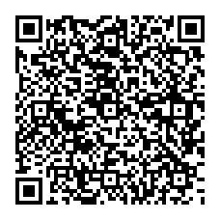
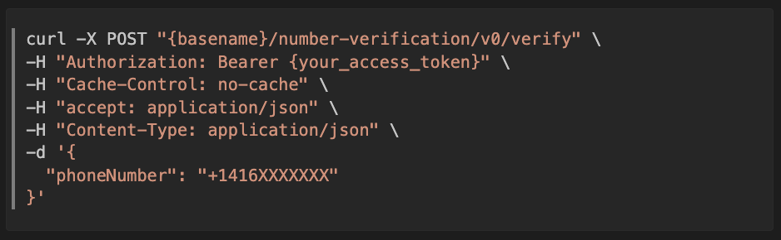
Getting Started – Number Verification Spec
NV@Swagger Editor Spec
Bash Shell Example using curl command
*For the purpose of the hackathon, you will be provided a basename and access token against our sandbox and not Microsoft Azure Programable Connectivity Platform

Slide 16
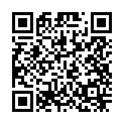
Getting Started Rogers Repository
Getting Started Repository - questsin/UBC-Rogers-CAMARA-Hackathon: UBC Rogers CAMARA Hackathon (github.com)

